Slide 1
Lecture 35:
Nomenclature of Carboxylic Acids
Reactions of Carboxylic Acids

Slide 2
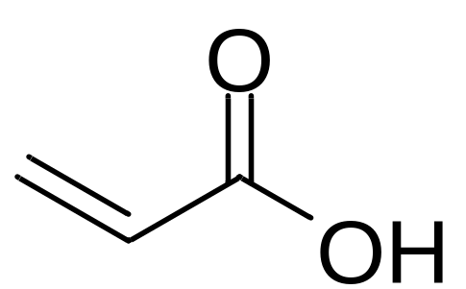
3
1
2
Propenoic acid

Slide 3
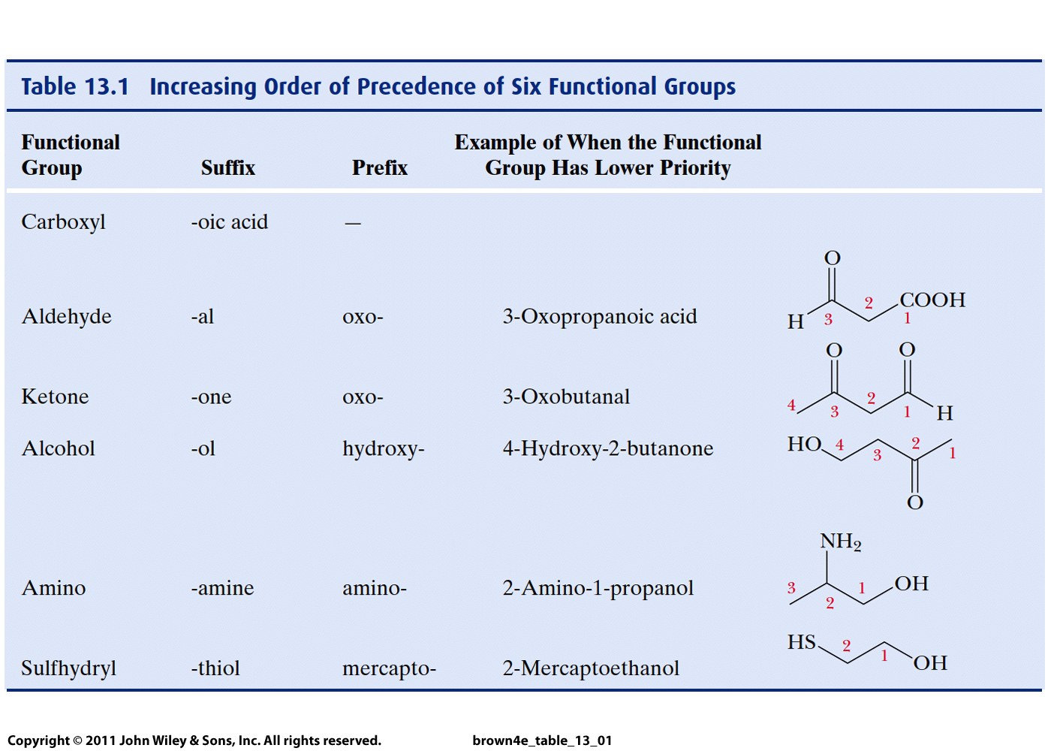

Slide 4
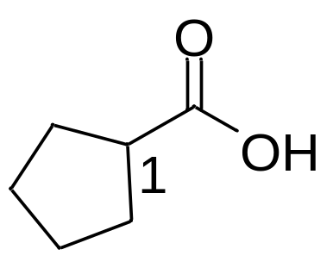
Cyclopentanecarboxylic acid
The carbon bound to COOH is numbered as 1

Slide 5
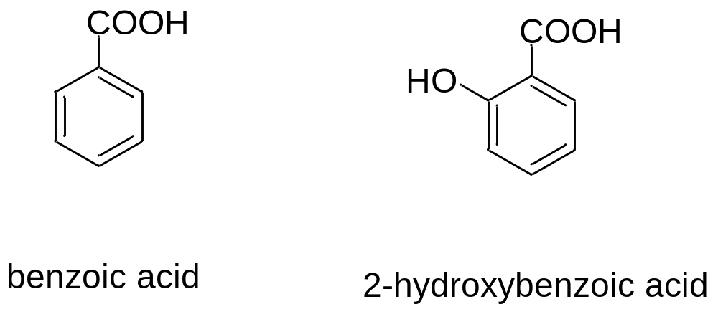

Slide 6
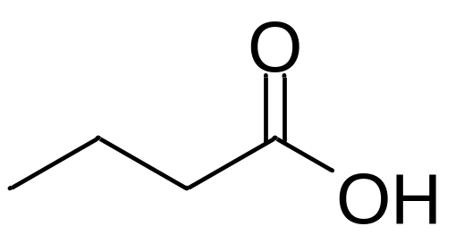
Carboxylic acids:
Highly polar
Form strong hydrogen bonds
Weak acids
Can be reduced to alcohols
Can be esterified to form esters

Slide 7
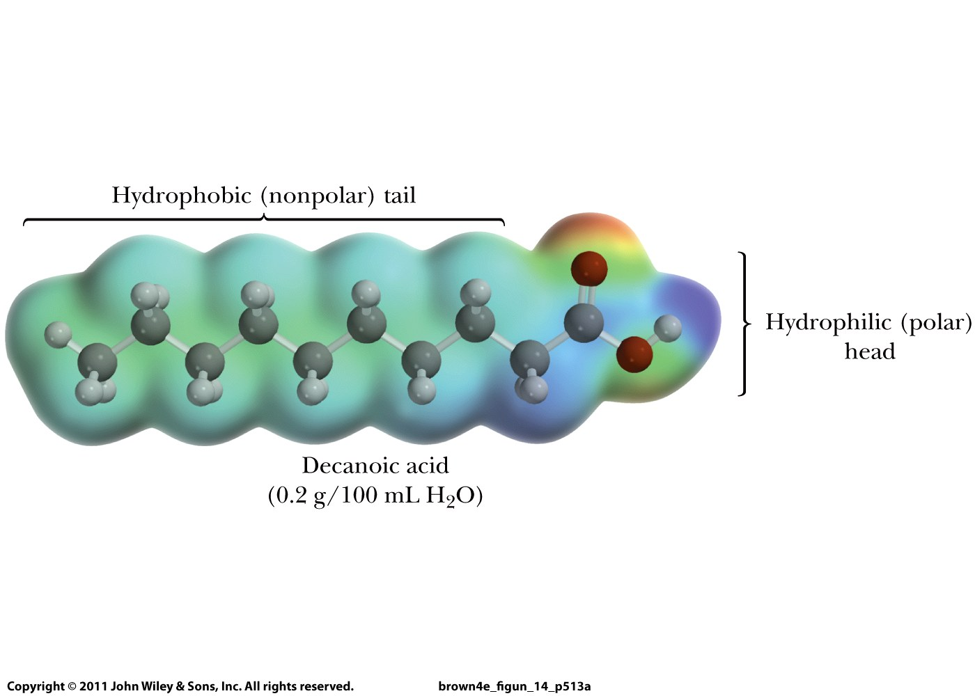

Slide 8
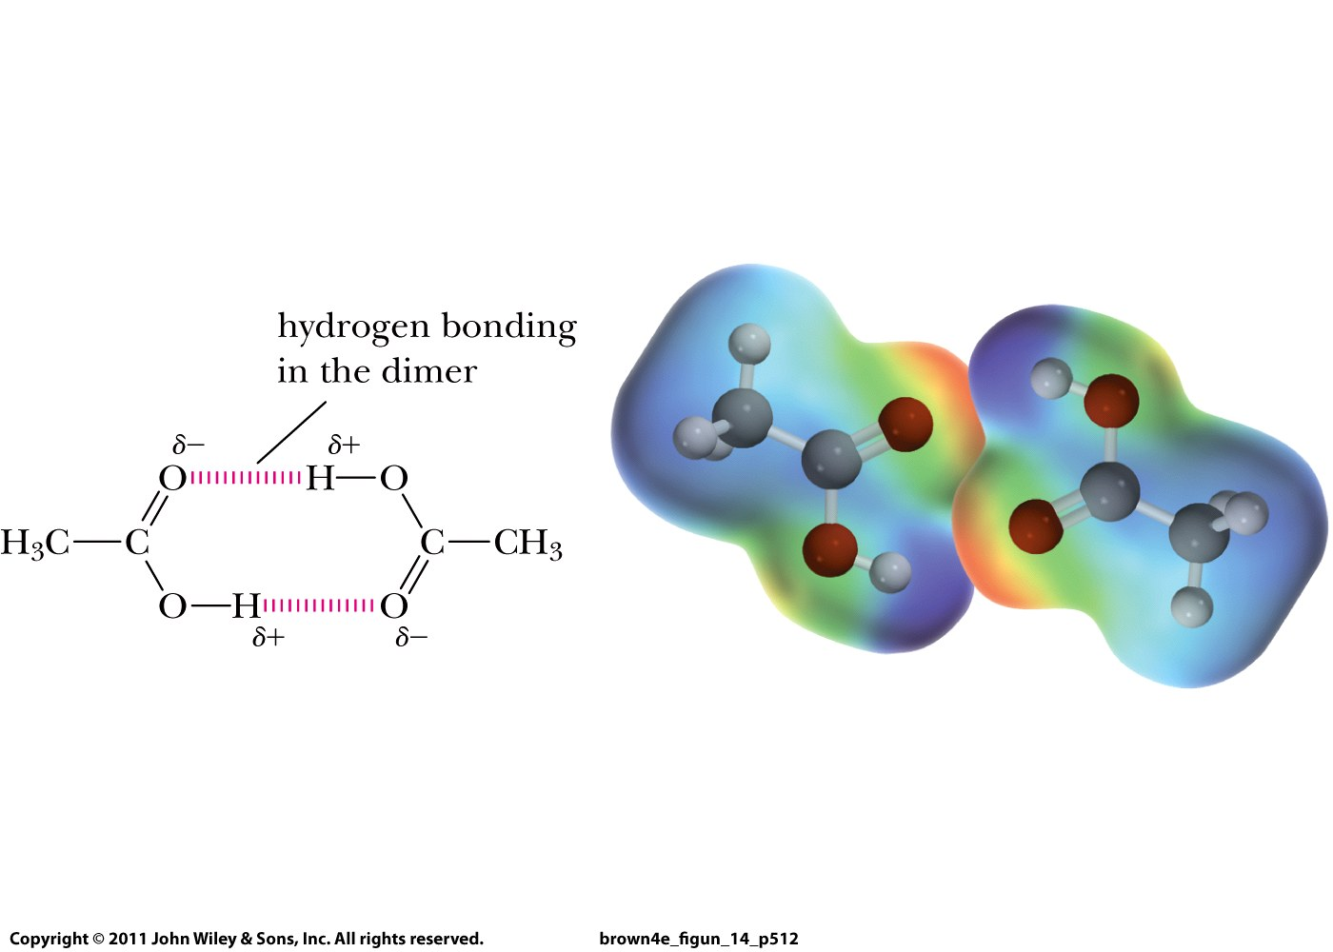

Slide 9
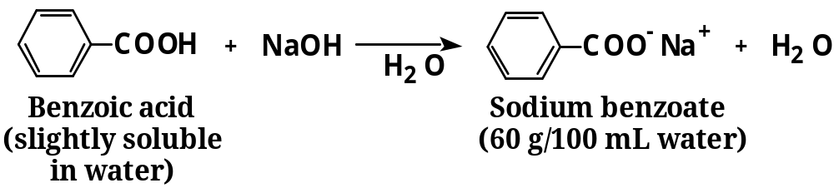

Slide 10
Carboxylic acids:
Highly polar
Form strong hydrogen bonds
Weak acids
Can be reduced to alcohols
Can be esterified to form esters

